Slide 1
CS50: Intro to ML
Kevin and Zad
Notes:
Outline;
What is ML (An overview of ML)
Supervised vs unsupervised ML model
What is feasible project for CS50 (how deep learning model requires lots of learning - like the learning of activation functions and hyperparameter tuning)
Coding environment (VScode Jupyter notebook, deepnote, Google Colab) - An example with deepnote & Google Colab
Examples
Libraries, data sources (Kaggle)
Resources : from CS50 (Ed, Google, Sklearn documentation)
Questions

Slide 2
What is ML?

Slide 3
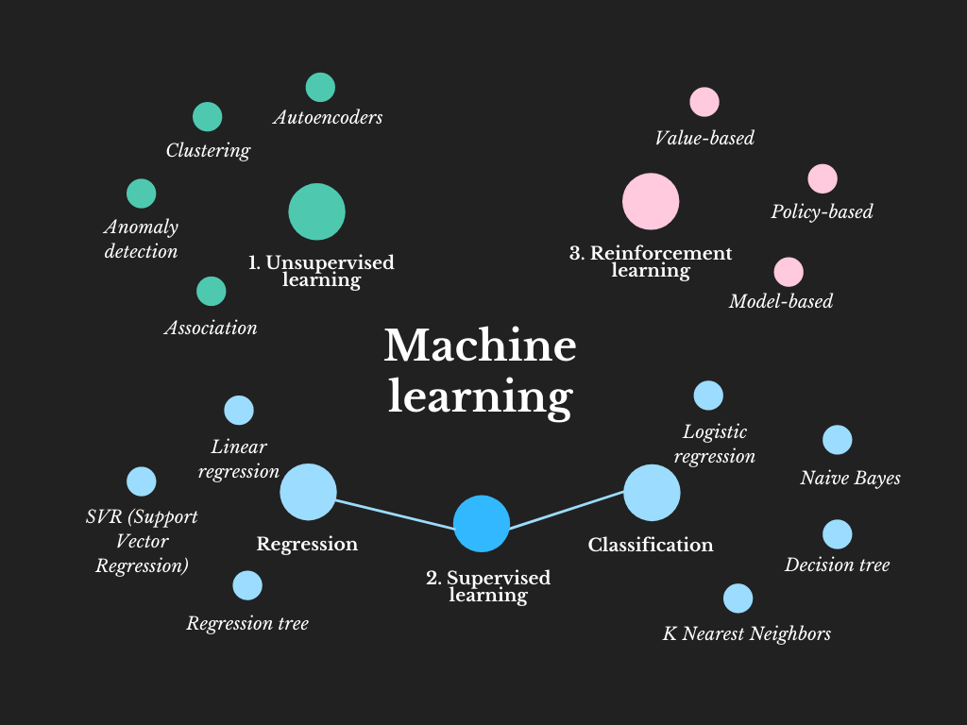

Slide 4
Supervised Learning
Given some labeled data, how can machines learn to predict labels that generalize to unseen data?

Slide 5
Unsupervised Learning
Given some unlabeled data, how can machines learn to find useful patterns or generalizations?
Notes:
Outline;
What is ML (An overview of ML)
Supervised vs unsupervised ML model
What is feasible project for CS50 (how deep learning model requires lots of learning - like the learning of activation functions and hyperparameter tuning)
Coding environment (VScode Jupyter notebook, deepnote, Google Colab) - An example with deepnote & Google Colab
Examples
Libraries, data sources (Kaggle)
Resources : from CS50 (Ed, Google, Sklearn documentation)
Questions

Slide 6
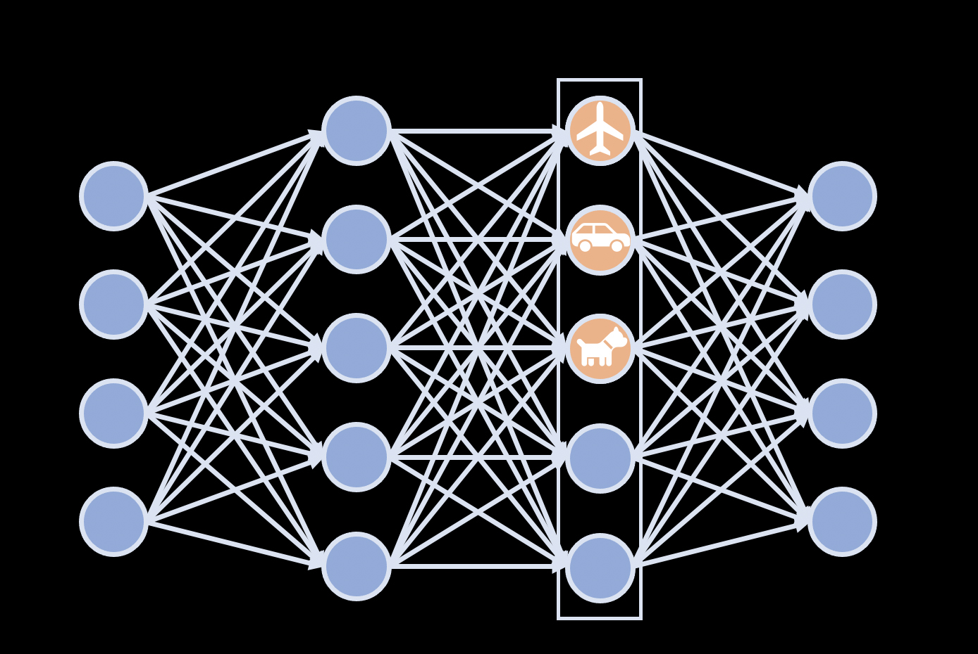

Slide 7
General Outline in ML project
Result & Improvise
Get the model performance and try to test it out with different ML models to check whether it improves accuracy (Example: Linear Regression -> Logistics Regression -> Neural network)
Data Collection
Finding sources of data: Scrapping it from websites, API calls, or readily available datasets from Kaggle.
** Scrapping raw data without cleaning might take a long time to clean**
04
01
03
Data Exploration
Be careful of noisy, high dimensional data; heatmap in trying to understand relations, or detecting biases in labels (so as not to affect accuracy)
Choosing ML Models
Choose a simple model to start with based on the type of question : Supervised (Regression or Classification) / Unsupervised
02
Notes:
Re

Slide 8
Questions?

Slide 9
Hands-on example

Slide 10
https://tinyurl.com/ML-notebook-1
Save a copy before you edit!

Slide 11
Questions?

Slide 12
For CS50 final project:
Only consider if:
You have background in ML, Python and strong grasp on the ML concept
** Required hyperparameter tuning and selection of activation function **
Reasonable consideration
It might require lots of data cleaning and parameter tuning to not underfit / overfit the data
Deep learning, CNN, RNN, GAN, ...
Unsupervised Learning, NLP
Supervised Learning
Reinforcement Learning
Notes:
Re

Slide 13
Coding Environment
Jupyter Notebook:
Deepnote
VSCode
Python Jupyter Notebook
Python File
Recommended if you want to integrate it to a website (ie: Python Flask web app)
Google Collab (GPU requirements)
Cloud Computing

Slide 14
Useful Python libraries for ML : Data
Data Mining:
BeautifulSoup
Scrapy
Data Source:
Kaggle
UCI ML repository
Scrap from website
API calls
Data processing:
Pandas
Numpy
Scipy
Depending on what model you are choosing: For example, image dataset; Yelp review for NLP model etc

Slide 15
Useful Python libraries for ML :
Visualizations
For data visualization:
Matplotlib
Seaborn
Plotly

Slide 16
Useful Python libraries for ML :
ML models
Sklearn: various classification, regression and clustering algorithms
Tensorflow: various tasks, but particular focus on training and inference of deep neural networks
Pytorch: neural network, computer vision and natural language processing
Keras: primarily for for developing and evaluating deep learning models.

Slide 17
ML Resources & Support
Ed
CS50 Intro to Artificial Intelligence
Python Libraries Documentation
Kaggle
Towards Data Science blog
Machine learning mastery blog
Stack Overflow
Github

Slide 18
ML Ethics
Deep Fake Example in CS50
Prof Finale Doshi-Valez: The importance of explainability in AI
MIT 6.S191:AI biases & Fairness
AI robustness
The Alignment Problem: Aligning ML with human values
Alan Turing Institute: Fairness, transparency, privacy

Slide 19
Questions?

Slide 20
Thank you!
Please take 1 minute to fill out this feedback form.
https://tinyurl.com/ML50-feedback

